Slide 1
The Serverless Framework

Slide 2
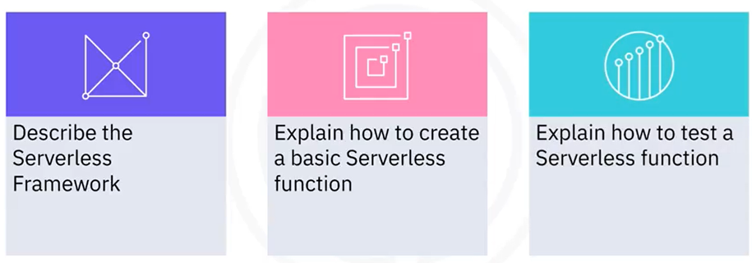
What you will learn

Slide 3

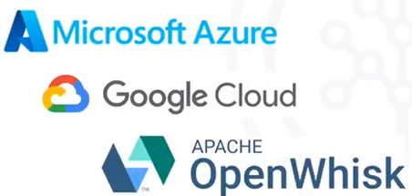
What is the Serverless Framework
The Serverless Framework is a free
and open-source web framework
written using Node.js

Slide 4
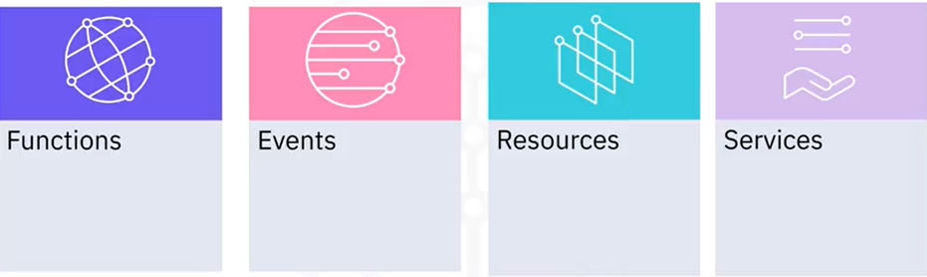
Serverless Framework Concepts

Slide 5

Functions
• The code
• Independent unit of execution and
deployment
• For example:
• Saving a user to the database
• Performing a scheduled job

Slide 6
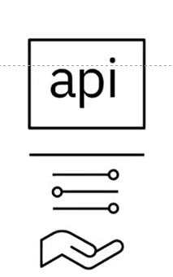
Events
• Functions are triggered by events
• For example:
• An HTTP Request
• A new file upload in an S3 bucket

Slide 7

Resources
• Resources are infrastructure components used by functions
• For example:
• A database
• An S3 bucket

Slide 8

Services
• A service is the Framework's unit of organization
• Service is where you define your
• Functions
• Events
• Resources to deploy

Slide 9
serverless.yml
service: products
functions:
productsCreate:
events:
- httpApi: 'POST /products/create'
productsDelete:
events:
- httpApi: 'DELETE /products/deletel
resources:

Slide 10
Serverless Framework — Hello World
Let's build and deploy a Hello World application using the
Serverless Framework on AWS
$ npm install -g serverless
$ serverless

Slide 11
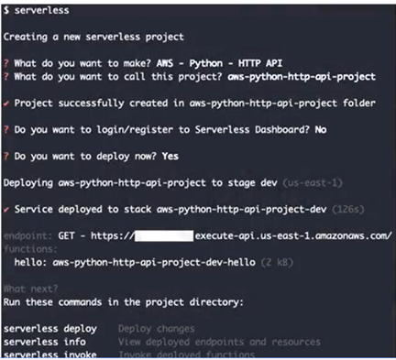
Serverless command

Slide 12

Change to hello world
def hello(event, context):
body = "Hello World!"
response = {"statusCode": 200, "body":body}
return response
$ serverless deploy

Slide 13
Recap
In this video, you learned that:
• The Serverless Framework is a free and open-source web
framework written using Node.js
• Functions are triggered by events
• A service is configured via a serverless.yml file
• There are specific sections in serverless.yml to specify
functions, events, and resources

